Slide 1
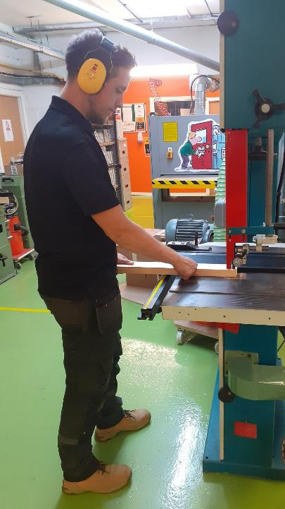



CITB Apprenticeship Standards
EMPLOYER BRIEF
Friday 12 February 2021, 15:00 – 16:00

Slide 2

Welcome
Lorraine Shepherd
NAS Training Manager
Today’s meeting: 15:00 – 16:00
This meeting is being recorded
Your microphones and camera are enabled
Please can any questions be placed in the chat

Slide 3

Content
Standards – background
Your Involvement
On-Programme Training:
  The Apprenticeship Standard Learner Journey
  Role of the Mentor
  Knowledge, Skills and Behaviours
  Off The Job Training
Gateway
End Point Assessment (EPA)
CITB Support for NAS Route

Slide 4
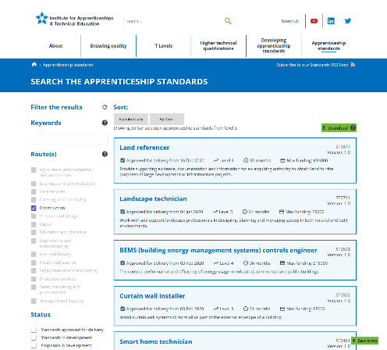
Standards – Background
Apprenticeship Standards have been developed in partnership with the Construction Sector.
The details of available Construction Standards can be found on the Institute for Apprenticeships and Technical Education (IFATE) website.
https://www.instituteforapprenticeships.org/apprenticeship-standards/?routes=Construction

Slide 5
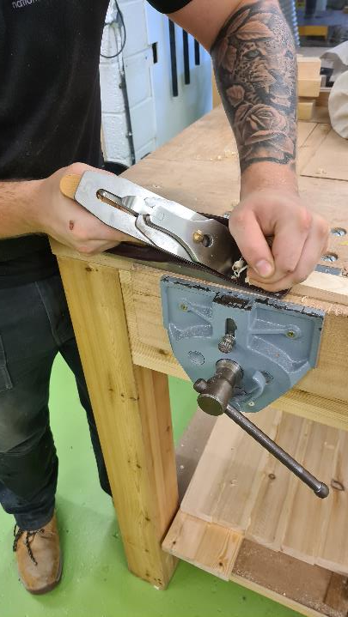
Your Involvement
Fully understand the requirements of the Standard and the Assessment Plan.
Develop an appropriate Apprentice job role for the Standard.
Fully employ the Apprentice until completion of the EPA.
Appoint a mentor to support the Apprentice.
Provide training on and off the job.

Slide 6
On-Programme Training: The Apprenticeship Standard Learning Journey
Initial assessment and interview
Knowledge, Skills and Behaviours
Gateway
End Point Assessment
Completion
and certification

Slide 7

On-Programme Training: Role of the Mentor
They will need to:
Have the skills set to assist with and manage the process
Have an understanding of the Standard and its Assessment Plan
Set high expectations
Listen
Observe
Encourage
Motivate and give feedback
Be empathetic and patient
Also the Training Provider with setting goals, completing reviews and contribute to confirming competence.
Notes:
The mentor’s role is a vital part of the Apprenticeship
Being a mentor can be an incredibly rewarding role but can have it’s challenges – Your Training Provider will be on hand to assist you. Voluntary Mentors often offer the best support for the apprentice.
A successful Apprenticeship will be achieved by everyone working together: the Employer, the mentor, the college and most importantly the learner.

Slide 8
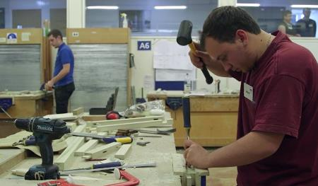
On-Programme Training: Knowledge, Skills and Behaviours
Knowledge – knowledge learnt at college and on site.
Skills – skills to carry out the job role. Learning, putting into practice and developing skills learnt at college.
Behaviours – communication, time management and organisational skills.
Notes:
They have been identified and developed by Employers and listed in the Standard and associated Assessment Plan
The On-Programme part of the Apprenticeship and is taught, embedded and revisited at college or in a training centre but most of it will take place in the workplace
Some examples :
Knowledge – the types, uses and purposes of pre fabricated beams, risk assessments and H&S legislation, the different types of fixings and their uses
Skills – set out and build a brickwork arch, hang a door, erect pavement scaffold
Behaviours – independent working, logical thinking, mature attitude
Behaviours –
B1: Effective communication: oral, written, listening, body language, presentation.
B2: Effective team working: work effectively with others with limited supervision.
B3: Independent working: take responsibility for completing their own work.
B4: Logical thinking: use clear and valid reasoning when making decisions
B5: Working effectively: undertake the work in a reliable and productive manner.
B6: Time management: use own time effectively to complete the work on schedule
B7: Adaptability: be able to adjust to changes to work instructions

Slide 9
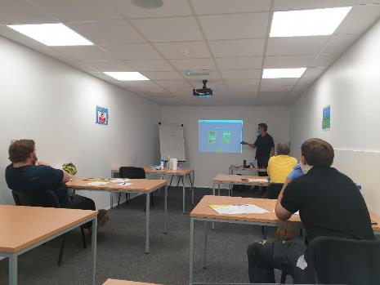
On Programme Training: Off The Job Training
A minimum of 20% Off The Job Training needs to take place.
This can include but is not limited to:
Observing
Practising
Simulation
Short courses
Mentor feedback
College attendance
Notes:
The 20% is calculated from the number of hours worked per week over the period of the apprenticeship up to Gateway. It must not be in addition to the normal working hours i.e. research completed in the evening.
This includes college attendance (not functional skills programmes) but this on its own will not cover 20% for the duration of the apprenticeship.
Off the job training does not mean training away from the site / workplace but is also training that is carried out at work with their mentor, supervisor or colleague.
It needs to be relevant to the occupation and Apprenticeship Standard
Some examples are - Observing, being coached, practicing, simulation work, tool box talks, short course, reading instructions/ manuals/ trade magazines, self directed study during working hours.
A carpentry examples could be - Observing someone hang a door, practicing chopping out a hinge on some scrap timber, being observed hanging a door, having feedback.

Slide 10

Gateway
This is when YOU the employer, consider your Apprentice to be occupationally competent against the Knowledge, Skills and Behaviours of the Standard Assessment Plan.
All training stops and the apprentice is put forward for the EPA.
Any resits will occur a cost to you.
Notes:
Gateway is when the apprentice completes the training part of the apprenticeship and is put forward for the EPA.
All mandatory elements must be complete – Maths, English and any additional required qualifications (NVQ, Btec, a portfolio of their best work, etc) plus the 20% OJT threshold has been reached.
A Gateway meeting will be held with the employer, the Apprentice and the college to consider if the Apprentice is occupationally competent against the knowledge, skills and behaviours of the Standard Assessment Plan.
All training stops and the apprentice put forward for the EPA. Remember – the apprentice needs to remain employed until the completion of the End Point Assessment. The EPA will take place within 3 months of Gateway.
Remember: the decision on occupational competency is ultimately yours. Any resits will occur a cost.
Note: Resits are where your apprentice fails part of the Standard (resit typically within 3 months) while a Retake is where much more training is required (retake typically taken within 6 months).

Slide 11

The End Point Assessment
Assessments could be over multiple days to assess that the Apprentice has acquired the correct Knowledge, Skills and Behaviours that the Standard requires and is carried out by an independent End Point Assessment Organisation (EPAO).
It may consist of:
Practical Assessment – 6 to 18 hours depending on trade
Knowledge test
Professional discussion, interview or questioning (portfolio)
Some higher level apprenticeships require a presentation
Notes:
Details for each Standards EPA is in the assessment plan
The End Point Assessment Organisation (EPAO) will provide an independent end point assessor – the assessment will probably take place at the centre where the training takes place but this may not always be the case.
The Apprentice can be awarded Pass, Merit, distinction
Carpentry for example is 2 days - 60 mins theory, 7 hrs practical, and discussion portfolio
While painting is 3 days - 1 ½hr theory , 18 hrs practical , portfolio of best work portfolio
You can chose an EPAO or use your Training Provider’s recommended choice.
Your Training Provider will organise the End Point Assessment, liaising with the End Point Assessment Organisation, the Apprentice and yourself.
They will make sure that the Apprentice receives the necessary preparatory material for the End Point Assessment and will work with the college wherever possible to ensure that the Apprentice has opportunities to practise mock knowledge and mock practical tests.
Part or whole resits or retakes can be arranged and this will occur an additional cost.
You will be informed of the result at the earliest opportunity. The certificate will be sent to you from the ESFA

Slide 12
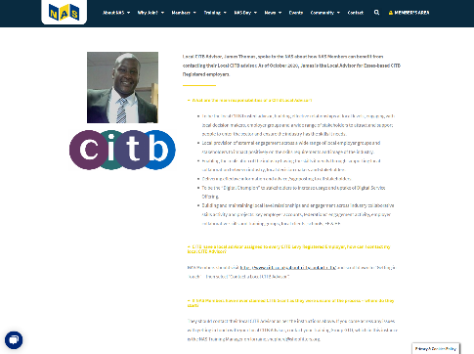
CITB Support for NAS Route
CITB considers the Standards to be learner-led and Employer endorsed.
This means we recommend you encourage the Apprentice to take ownership of their training programme and learning towards the required Knowledge, Skills and Behaviours of the Standard.
The Apprenticeship is a continuous learning cycle. This means all the knowledge, skills and behaviours need to be taught, embedded, and revisited throughout the programme.
Your Training Provider will work with you and your Apprentice to set bespoke milestones and targets which will subsequently be used to monitor and record progression towards the achievement of the Standard.
Notes:
CITB have developed many resources in order to help the process. These include an Individual Learning and Development Plan and Workplace Activity Records which allows the Apprentice to record skills developed and achieved as a result of workplace opportunities that they encounter as part of their job role.
Apprenticeship Grants for attendance and achievement are available for CITB registered employers.
More information on the grants and how to apply can be found on the CITB website - https://www.citb.co.uk/levy-grants-and-funding/grants-funding/apprenticeship-grants/apprenticeship-grants-intermediate/
Or alternatively speak to your local Advisor or Apprenticeship Officer.

Slide 13



Thank you
Q&A

